Slide 1


React JS
(textarea & select)
Lecture-27

Slide 2
Today’s Agenda
TextArea In HTML
TextArea In React
DropDown List In HTML
DropDownList In React
Examples

Slide 3
TextArea In React
In HTML the value of a textarea was the text between the start tag <textarea> and the end tag </textarea>.
In HTML
<textarea>
Content of the textarea.
</textarea>

Slide 4
TextArea In React
The textarea element in React is slightly different from ordinary HTML.
In React the value of a textarea is placed in a value attribute

Slide 5
Solution
AboutUs.js
import React, { Component } from "react";
class AboutUs extends Component {
constructor(props) {
super(props);
this.state = {
value: "Your views about SCA.",
};
this.handleChange = this.handleChange.bind(this);
this.handleSubmit = this.handleSubmit.bind(this);
}
handleChange(event) {
this.setState({ value: event.target.value });
}
handleSubmit(event) {
alert("A review was submitted: " + this.state.value);
event.preventDefault();
}

Slide 6
Solution
AboutUs.js
render() {
return (
<form onSubmit={this.handleSubmit}>
<label htmlFor="review">Review Us</label>
<br />
<textarea
id="review"
value={this.state.value}
onChange={this.handleChange}
/>
<br />
<button>Submit</button>
</form>
);
}
}
export default AboutUs;

Slide 7
Solution
MyComponent.js
import React, { Component } from "react";
import AboutUs from "./AboutUs";
class MyComponent extends Component {
render() {
return (
<div>
<AboutUs />
</div>
);
}
}
export default MyComponent;

Slide 8

OUTPUT

Slide 9
Select In React
In HTML, the selected value in the drop down list was defined with the selected attribute:
In HTML
<select>
<option value="Indian">Indian</option>
<option value="Mughlai">Mughlai</option>
<option value="Chinese" selected >Chinese</option>
</select>

Slide 10
Select In React
A drop down list, or a select box, in React is also a bit different from HTML.
In React, the selected value is defined with a value attribute on the select tag:

Slide 11
Solution
FavFood.js
import React, { Component } from "react";
class FavFood extends Component {
constructor(props) {
super(props);
this.state = { value: "Chinese" };
this.handleChange = this.handleChange.bind(this);
this.handleSubmit = this.handleSubmit.bind(this);
}
handleChange(event) {
this.setState({ value: event.target.value });
}
handleSubmit(event) {
alert("Your favorite food is: " + this.state.value);
event.preventDefault();
}

Slide 12
Solution
FavFood.js
render() {
return (
<form onSubmit={this.handleSubmit}>
<label htmlFor="favfood">
<b>Pick your favorite food:</b>
</label>
<br />
<select
id="favfood"
value={this.state.value}
onChange={this.handleChange}
>
<option value="Indian">Indian</option>
<option value="Mughlai">Mughlai</option>
<option value="Chinese">Chines</option>
<option value="Thai">Thai</option>
</select>
<br />
<button>Submit</button>
</form>
);
}
} export default FavFood;

Slide 13
Solution
MyComponent.js
import React, { Component } from "react";
import FavFood from "./FavFood";
class MyComponent extends Component {
render() {
return (
<div>
<FavFood />
</div>
);
}
}
export default MyComponent;

Slide 14
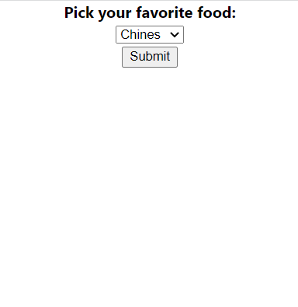
OUTPUT

